Slide 1

yOUR ONE AND ONLY TRADING BOT
NO SERIOUSLY, WE MEAN IT!

Slide 2

GET READY!

Slide 3
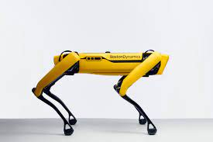
WOULD YOU TRUST THIS BOT TO MAKE YOUR BUYING DECISIONS?

Slide 4
CONTRIBUTORS
JIHAD AL-HUSSAIN
JOHN GAFFNEY
SHANEL KUCHERA
KAZUKI TAKEHASHI
PATRICK THORNQUIST

Slide 5



CORE MESSAGE
CAN AUTOMATED STRATAGIES USE STOCK ANALYTICS AND CONSUMER SENTIMENT TO HELP YOU MAKE BETTER DECISIONS?

Slide 6
CREATING AN ALL-IN-ONE DASHBOARD
CAN A BOT SERVE AS AN AID FOR MAKING DATA DRIVEN MARKET DECISIONS VIA RSI & SENTIMENT ANALYSIS?
THE RSI IS A LEADING INDICATOR
DOES CONSUMER SENTIMENT AFFECT STOCK MOVEMENTS OR PRICE?
TO REMOVE MISTAKES DUE TO FEAR OR GREED

Slide 7

TECHNOLOGIES USED
PYVIZ
WORDCLOUD
MONTE CARLO SIMULATION
SENTIMENT ANALYSIS VIA TWEEPY
SOCIAL MEDIA AND WEB SCRAPING
NLP

Slide 8
API’S
ALPACA
CRYPTO API COMING SOON
ALPHA VANTAGE
TWITTER

Slide 9
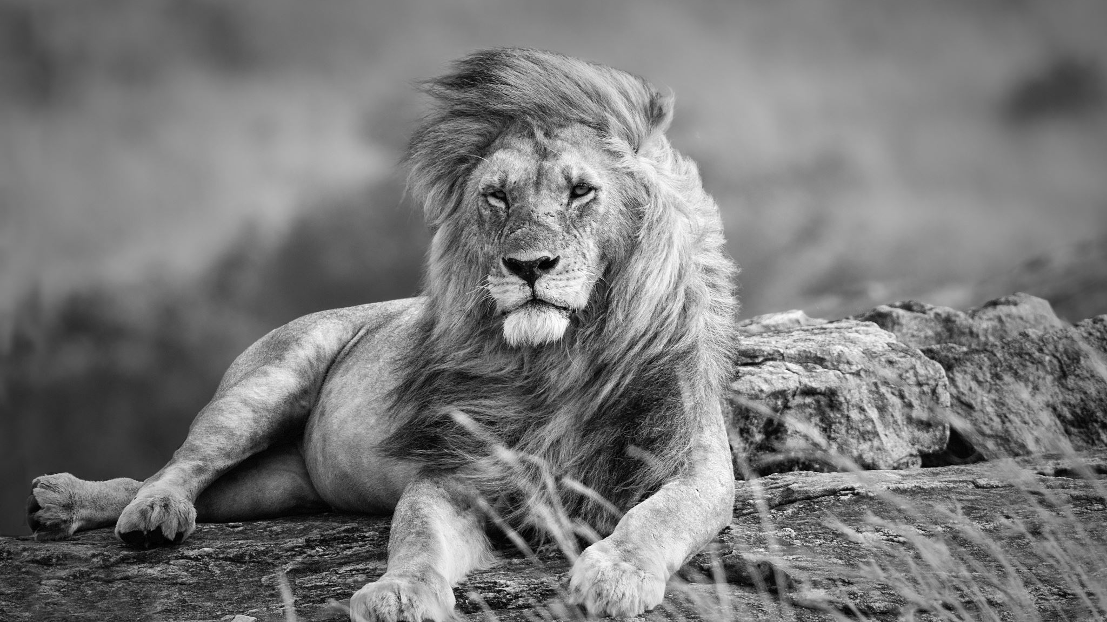
DIFFICULTIES ENCOUNTERED
Reddit API was not easy to use — Notes : the use case of gathering data from many subreddits at the same time for any text input of stock would require more work to understand the structure of the module PRAW and the reddit API
Data Cleaning of twitter data to ensure unbiased results — Notes : due to a limitation of the developer API privileges , we were unable to have a large enough dataset per day to calculate more meaningful analytics
Chart plotting with preferred library could not be integrated into panel objects — Notes: more research on other libraries would help create better visuals

Slide 10
DASHBOARD INSIGHTS
“BUY!”
“NOT SURE”
“ARE YOU CRAZY?! DON’T BUY”

Slide 11
BOT ALGORITHM
RSI INDICATOR: -1 IF ABOVE 70, +1 IF BELOW 30
PE RATIO: -1 IF ABOVE 30, +1 IF BELOW 15
FEAR AND GREED: +1 IF BOTTOM 1/3, -1 IF TOP 1/3

Slide 12
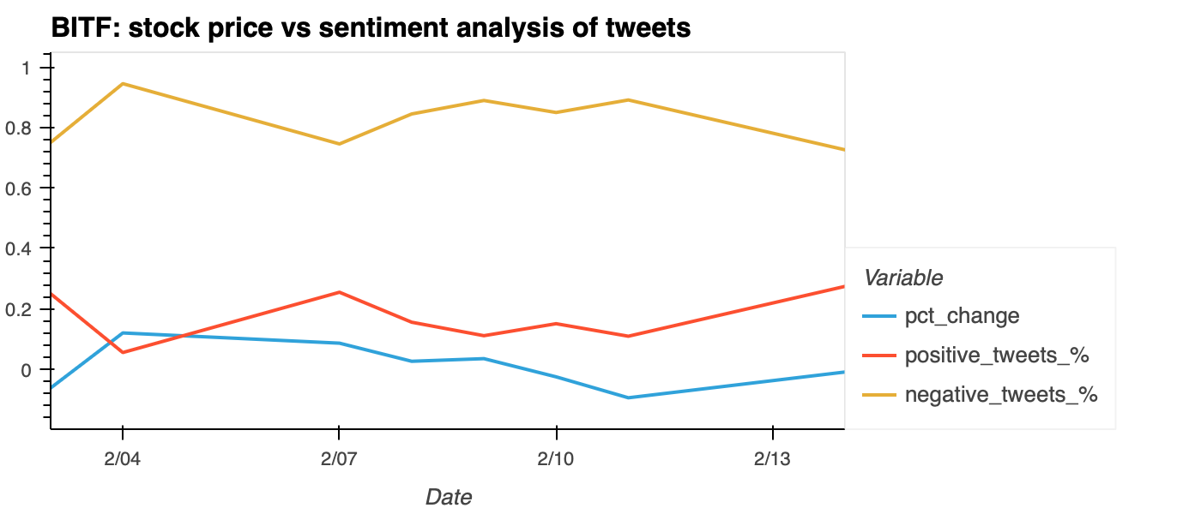
BITF: Stock price vs. Sentiment analysis of tweets

Slide 13
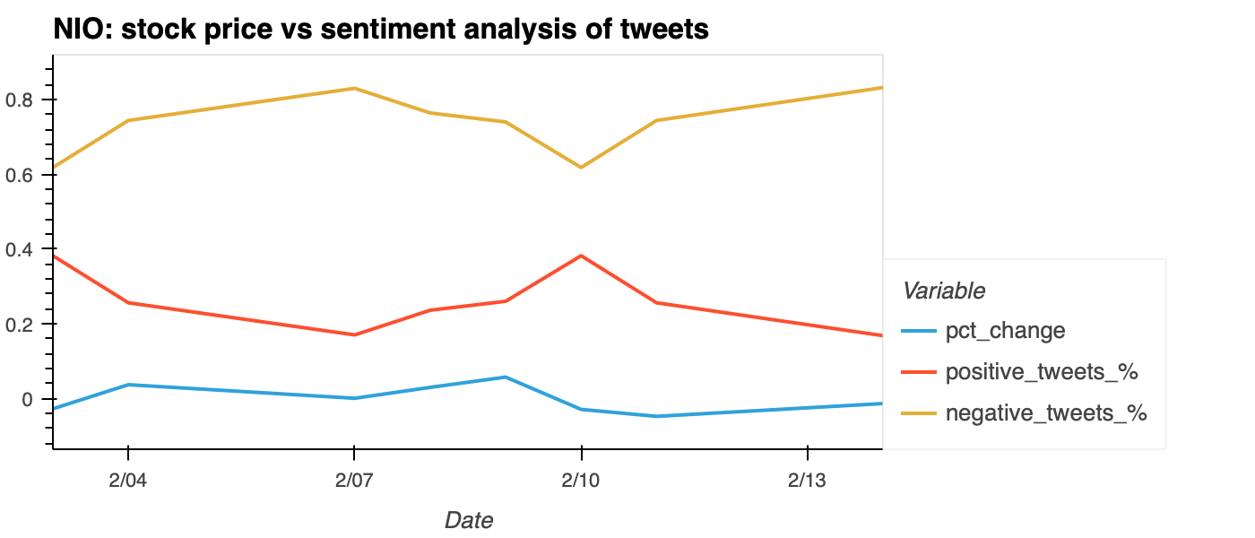
NIO: STOCK PRICE VS. SENTIMENT ANALYSIS OF TWEETS

Slide 14
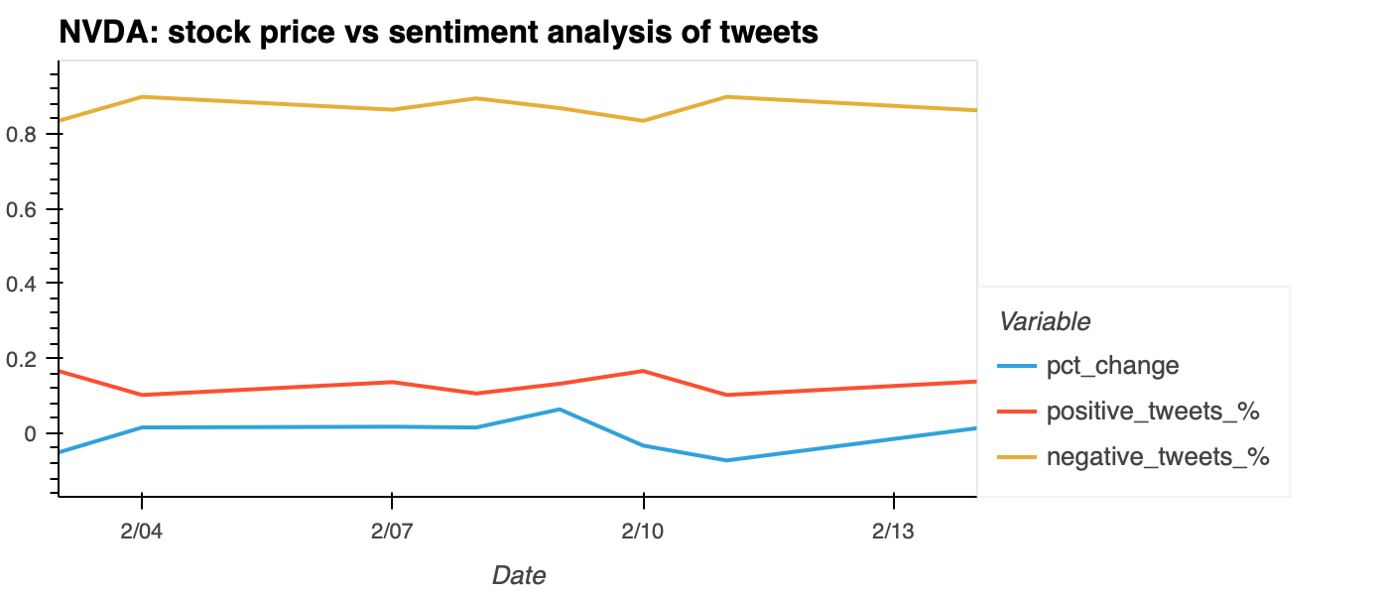
NVDA: STOCK PRICE VS SENTIMENT ANALYSIS OF TWEETS

Slide 15

EXAMPLE OF WORDCLOUD : BITF

Slide 16
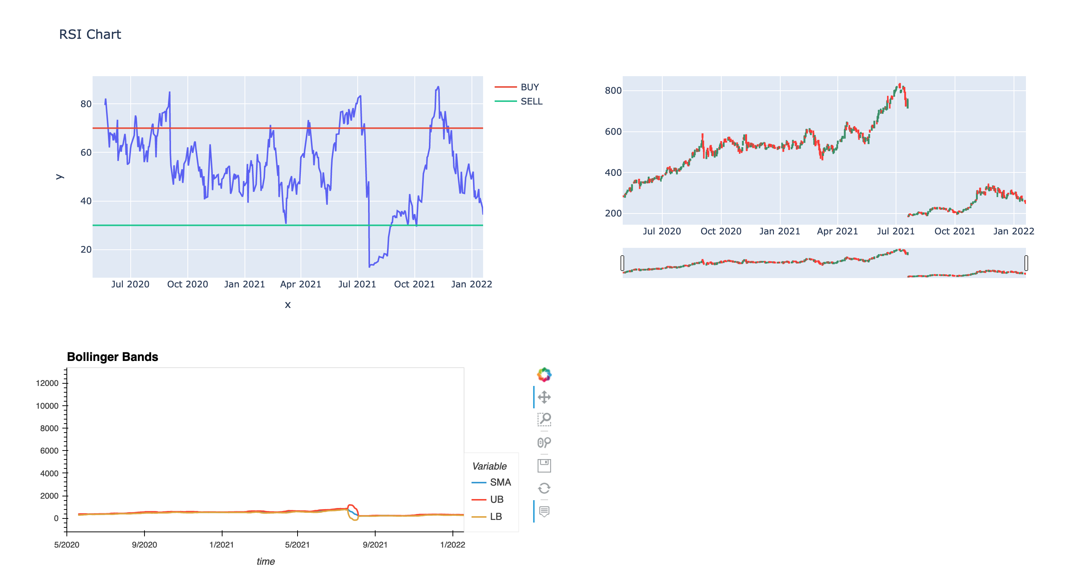
RSI CHART/ BOLLINGER BANDS

Slide 17
CONCLUSION & FUTURE OF THE BOT
WHILE OUR BOT ISN’T 100 % THE POTENTIAL IS THERE AND THE INFORMATION IS VALUABLE.
THERE IS POTENTIAL FOR FURTHER IMPROVEMENT!
WITH MORE TIME WE CAN ADD IN ADDITIONAL METRIX
ADDITIONAL INFORMATION WILL PROVIDE MORE STRATEGY
MACHINE LEARNING WILL USE AI AND WITH TIME IT WILL IMPROVE ITSELF
WE COULD USE MACHINE LEARNING TO TRANSITION FROM A LAGGING BOT TO A LEADING BOT
USE AI AND MACHINE LEARNING TO PREDICT WHAT COMES NEXT

